Slide 1
Concept Selection

Slide 2
Concept A
Features | Concept A | Concept B | Concept C
 | option 1 | option 2 | Option 3 | Option 4
sensors | Infrared | Optic Encoder | potentiometer
LEDs | RGB LEDs | SMD | Triple out high power | Piranha Super-Flux
Motor Type | DC |  | AC
Motor | Brushed | Brushless | Synchronous | Induction(squirrel cage)
direction of spin | vertical axis | horizontal axis
microcontroller | arduino | PSoC | PiC
materials | aluminum | plastic | wood | steel
Power systems | 9V battery | AA battery | AAA battery

Slide 3
Concept B
Features | Concept A | Concept B | Concept C
 | option 1 | option 2 | Option 3 | Option 4
sensors | Infrared | Optic Encoder | potentiometer
LEDs | RGB LEDs | SMD | Triple out high power | Piranha Super-Flux
Motor Type | DC |  | AC
Motor | Brushed | Brushless | Synchronous | Induction(squirrel cage)
direction of spin | vertical axis | horizontal axis
microcontroller | arduino | PSoC | PiC
materials | aluminum | plastic | wood | steel
Power systems | 9V battery | AA battery | AAA battery

Slide 4
Concept C
Features | Concept A | Concept B | Concept C
 | option 1 | option 2 | Option 3 | Option 4
sensors | Infrared | Optic Encoder | potentiometer
LEDs | RGB LEDs | SMD | Triple out high power | Piranha Super-Flux
Motor Type | DC |  | AC
Motor | Brushed | Brushless | Synchronous | Induction(squirrel cage)
direction of spin | vertical axis | horizontal axis
microcontroller | arduino | PSoC | PiC
materials | aluminum | plastic | wood | steel
Power systems | 9V battery | AA battery | AAA battery

Slide 5
Scoring Matrix
Concept Selection
 | Concept A | Concept B | Concept C
criteria
cost(.3) | 0 | - | -
weight(.1) | 0 | - | -
design simplicity(.3) | 0 | - | -
safety(.1) | 0 | + | +
visibility(.2) | 0 | 0 | 0
Sum | 0 | -.6 | -.6

Slide 6
5&6 Electrical Design

Slide 7
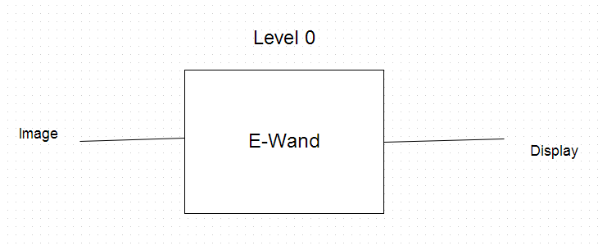
Concept Design

Slide 8
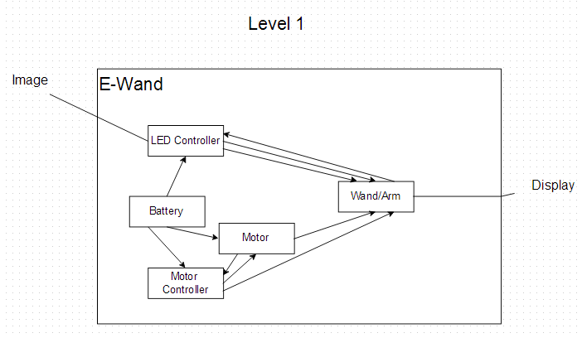
Concept Design

Slide 9
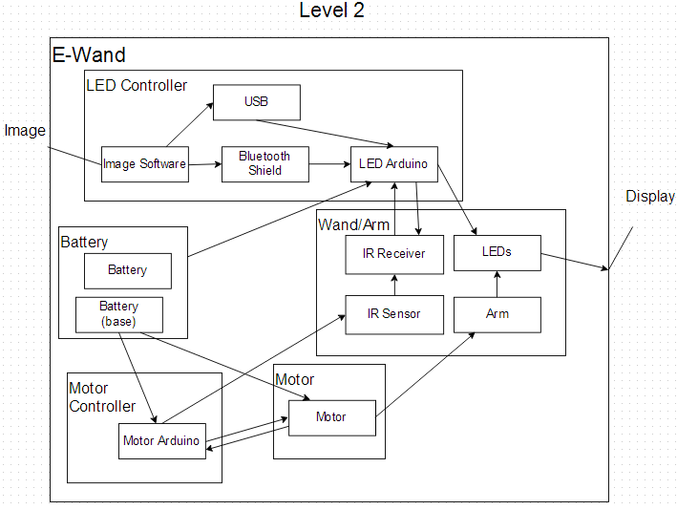
Concept Design

Slide 10
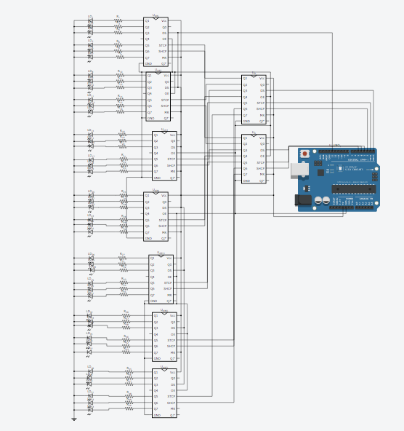
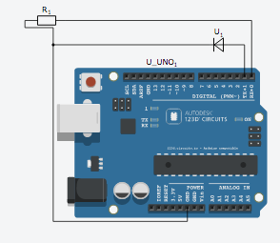
Detailed Design

Slide 11
Truth Table
 | Pin 1 | Pin 2 | Pin 3 | Pin 4 | Pin 5 | Pin 6 | Pin 13
LED1 | 1 | 0 | 0 | 0 | 0 | 0 | 0
LED2 | 0 | 0 | 0 | 1 | 0 | 0 | 0
LED3 | 1 | 0 | 0 | 1 | 0 | 0 | 0
LED5 | 1 | 0 | 0 | 0 | 0 | 0 | 1
LED6 | 0 | 0 | 0 | 1 | 0 | 0 | 1
LED7 | 1 | 0 | 0 | 1 | 0 | 0 | 1
LED8 | 0 | 1 | 0 | 0 | 0 | 0 | 0

Slide 12
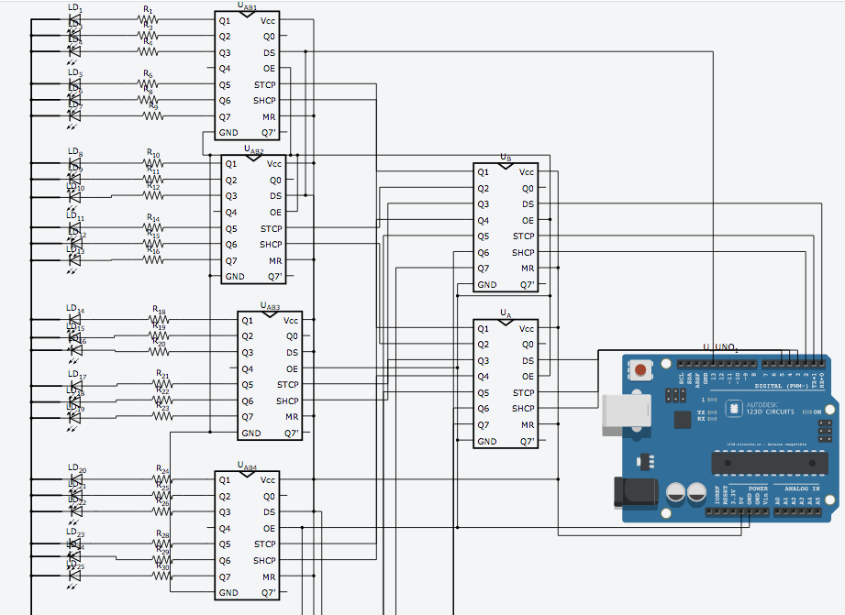
Decoder

